Slide 1

SDE Readiness Training
Empowering Tomorrow’s Innovators

Slide 2

Module I
Java Software Development: Effective Problem Solving

Slide 3

Introduction to Java
Learning Level: Basic
Date :

Slide 4
Contents
Introduction to Java
Java Tokens
Read User Input

Slide 5


Introduction to Java
Please download pictures in suitable size here and insert them by clicking the symbol above.

Slide 6
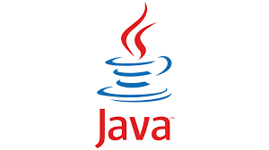
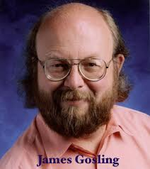
What is Java?
Introduction to Java
Java is a general-purpose, object-oriented, concurrent, and secured programming language.
It is a widely used robust technology.
It is a platform – Has a runtime environment (JRE) and a comprehensive set of APIs that allow developers to build and run Java applications across different hardware and operating systems.
James Gosling – the father of Java.

Slide 7
History
Introduction to Java
Java’s initial work started in 1990 by Sun Microsystems engineer Patrick Naughton as a part of the Stealth Project.
The Stealth Project soon changed to the Green Project, with Mike Sheridan and James Gosling joining the ranks, and the group began developing new technology for programming next-generation smart appliances.
James Gosling, Mike Sheridan, and Patrick Naughton initiated the Java language project in June 1991.
Gosling attempted to modify and extend C++ but quickly abandoned this approach in favor of creating an entirely new language.

Slide 8
History
Introduction to Java
Firstly, it was called "Greentalk" by James Gosling, and file extension was .gt. After that, it was called Oak, named after the tree that stood outside his office.
Originally designed for small, embedded systems in electronic appliances like set-top boxes. Then incorporate some changes based on emergence of World Wide Web, which demanded portable programs.
In 1995, Oak was renamed as "Java" because it was already a trademark by Oak Technologies.
The first publicly available version of Java (Java 1.0) was released in 1995.
In 2006 Sun started to make Java available under the GNU General Public License (GPL). Sun Microsystems was acquired by the Oracle Corporation in 2010. Oracle continues this project called OpenJDK.

Slide 9
Where it is used?
Introduction to Java
Java is almost everywhere and more than 60 billion devices run Java.
It is used create desktop Applications, Web Applications, Enterprise Applications such as banking applications, mobile applications.
Web services and Cloud-based applications.
Embedded System
Games etc.,

Slide 10
Editions
Introduction to Java
J2SE (JavaPlatform, Standard Edition)
Java 2 Standard Edition
Used to create applications for Desktop Environment
J2ME
(Java Platform, Micro Edition)
Java 2 Micro Edition
Used to create applications for mobile Devices
J2EE (Java Platform, Enterprise Edition)
Used to create applications for Enterprise.
Jakarta EE/Java 2 Enterprise Edition
Community driven Edition.

Slide 11
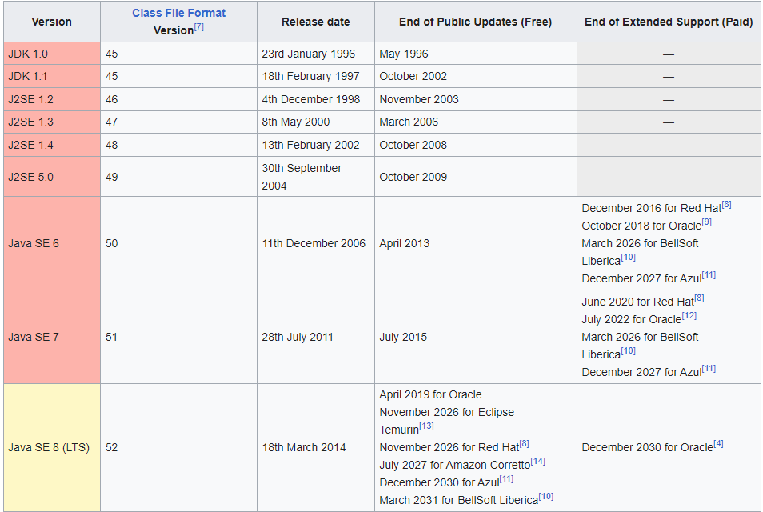
Version
Introduction to Java

Slide 12
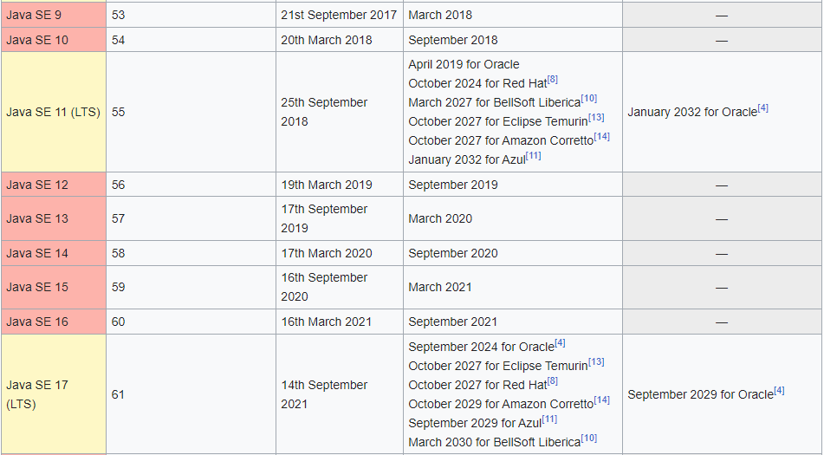
Version
Introduction to Java

Slide 13
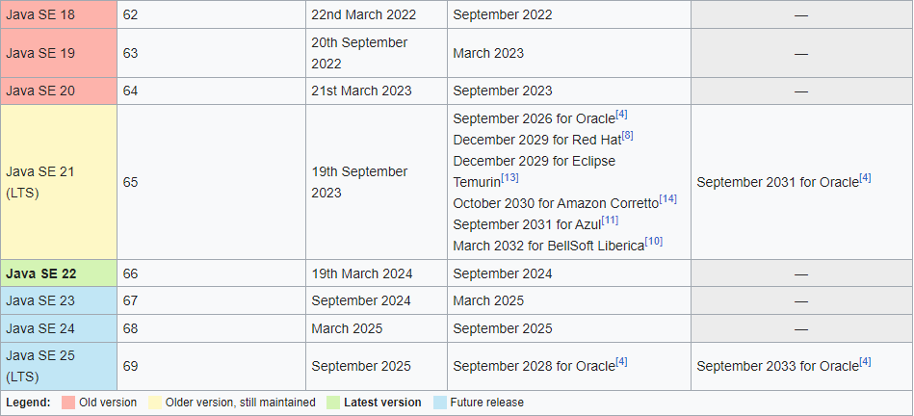
Version
Introduction to Java

Slide 14
Environment
Introduction to Java
Java includes many development tools, classes, and methods.
Development tools are part of Java Development Kit (JDK)
The classes and methods are part of Java Standard Library (JSL), also known as Application Programming Interface (API).
It includes hundreds of classes and methods grouped into several packages according to their functionality.

Slide 15
Environment - JDK
Introduction to Java
Java Development Kit(JDK) : It is a software development kit used by Java developers for building Java applications.
Includes tools, libraries, and documentation necessary for Java development.
JDK consists of :
Java Compiler (javac): Translates Java source code into bytecode.
Java Runtime Environment (JRE): Includes a version of the JRE, which provides the runtime environment for executing Java applications. The JRE consists of the JVM and libraries required for running Java bytecode.

Slide 16
Environment - JDK
Introduction to Java
JDK consists of :
Java Development Tools:
Java Debugger (jdb): A tool for debugging Java programs.
Java Archive (JAR) tool: A utility for creating and managing JAR files, which are compressed archives that contain Java classes and resources.
JavaDoc tool: A tool for generating HTML documentation from Java source code comments
JDK = Java Runtime Environment (JRE) + Development Tool

Slide 17
Environment - JRE
Introduction to Java
JRE (Java Runtime Environment) is a software package that provides Java class libraries, Java Virtual Machine (JVM), and other components that are required to run Java applications.
JRE is the superset of JVM.
JRE = Java Virtual Machine (JVM) + Library Classes

Slide 18
Environment - JVM
Introduction to Java
Java Virtual Machine(JVM) : It's a virtual machine that allows a computer to run Java programs.
JVM is a runtime environment that loads, verifies, and executes Java bytecode, and converts bytecode to machine-specific code.
JVM consists of three distinct components:
Class Loader
Runtime Memory/Data Area
Execution Engine

Slide 19
Environment - JVM
Introduction to Java
Class loader:
Responsible for loading classes into the JVM.
When you run a Java program, the class loader searches for the necessary classes and loads them into the runtime data area.
Runtime data area:
JVM stores data in the runtime data area during program execution.
It consists of several different areas:
Method area: Where class and method information is stored
Heap: Where objects are stored.
Stack: Where method calls and local variables are stored.

Slide 20
Environment - JVM
Introduction to Java
Execution engine :
Responsible for executing the bytecode (compiled Java code) with the help of Java interpreter and JIT compiler that is loaded into the JVM.
The JVM also includes a garbage collector, which automatically frees up memory that is no longer being used by the program.
Java Interpreter + Just-In-Time Compiler(JIT)

Slide 21
Environment - JVM
Introduction to Java
Interpreter
The interpreter reads and executes the bytecode instructions line by line. Due to the line-by-line execution, the interpreter is comparatively slower.
Another disadvantage of the interpreter is that when a method is called multiple times, every time a new interpretation is required.
JIT Compiler
The JIT Compiler overcomes the disadvantage of the interpreter. The Execution Engine first uses the interpreter to execute the byte code, but when it finds some repeated code, it uses the JIT compiler.
The JIT compiler then compiles the entire bytecode and changes it to native machine code. This native machine code is used directly for repeated method calls, which improves the performance of the system.

Slide 22
Environment
Introduction to Java
JDK (JRE + Development Tools)
javac, jar, debugging tools,javap
JRE (JVM + JSL)
java,javaw, libraries, jar
JVM (Java Interpreter + Just-In-Time Compiler )
Note
JVM, JRE and JDK are ported to different platforms to provide hardware and operating system-independence.

Slide 23
Difference - JDK vs JRE vs JVM
Introduction to Java
 | JDK | JRE | JVM
Full From | Java Development Kit | Java Runtime Environment | Java Virtual Machine
Definition | Software development kit provided for developing Java applications | Software package that provides the runtime environment for executing Java applications. | Abstract machine that provides an environment for the execution of Java Bytecodes.
Tools | Includes tools and libraries for developing, debugging, and profiling Java applications. | Includes the JVM, class libraries, and other runtime components required to run Java applications | Does not include any software tools
Implementation | JDK : JRE + Development tools | JRE : JVM + Class libraries | JVM : provides a runtime environnent.

Slide 24
Features
Introduction to Java
Simple – Java syntax based on earlier languages like C and C++. Designed considering the pitfalls of earlier languages
Object Oriented – Java supports all the Object Oriented features.
Secured – No explicit pointer support, run inside the java virtual machine sandbox. The class loader, byte code verifier and security manager component of JVM enable the secured environment. Java also supports application developer to use other security mechanism like SSL, JAAS, Cryptography, etc.

Slide 25
Features
Introduction to Java
Robust – Java have strong memory management, lack of pointers that avoids security problems, automatic garbage collection, exception handling and the type checking.
Platform Independent - Once compiled ,code will be run on any platform without recompiling or any kind of modification -“Write Once Run Anywhere(WORA)”. This is made possible by making use of a Java Virtual Machine(JVM).
Note
JVM, JRE and JDK are ported to different platforms to provide hardware and operating system-independence.

Slide 26
Features
Introduction to Java
Architecture-neutral – the size of primitive types is fixed
Distributed – Java enable to create distributed application with the help of RMI and EJB
Multi-threaded – Java run application concurrently.

Slide 27
Environmental Setup
Introduction to Java
To run Java applications, we need to prepare the environmental setup. For installing Java we need the following:
The Java Runtime Environment (JRE) (Includes Java Virtual Machine (JVM))
The Java Developer Kit (JDK) ( Includes the Java Compiler)
A text editor
If JDK is installed, you automatically get the JRE
It can be downloaded here: Java Downloads | Oracle India

Slide 28
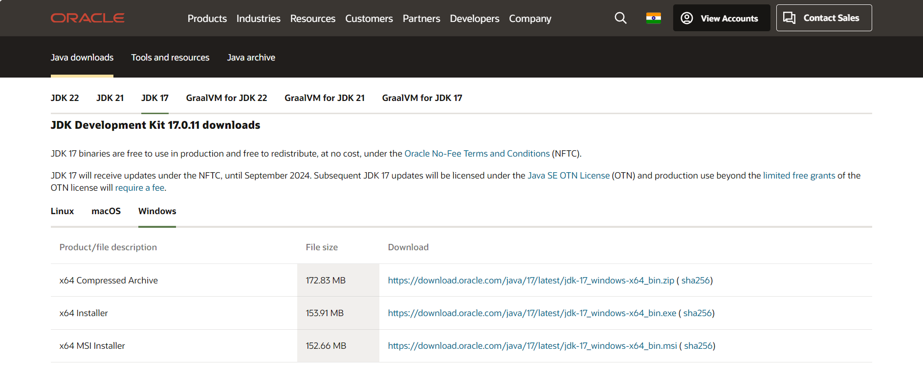
Environmental Setup
Introduction to Java
Click here to download the JDK17(LTS) version

Slide 29
Eclipse IDE
Introduction to Java
Using a text editor is the basic way of creating a Java program, but there are tools available to make it easier to create Java programs called IDEs like Eclipse.
Eclipse is a third-party open-source IDE that is very powerful and popular.
It can be downloaded here: http://www.eclipse.org/downloads/

Slide 30
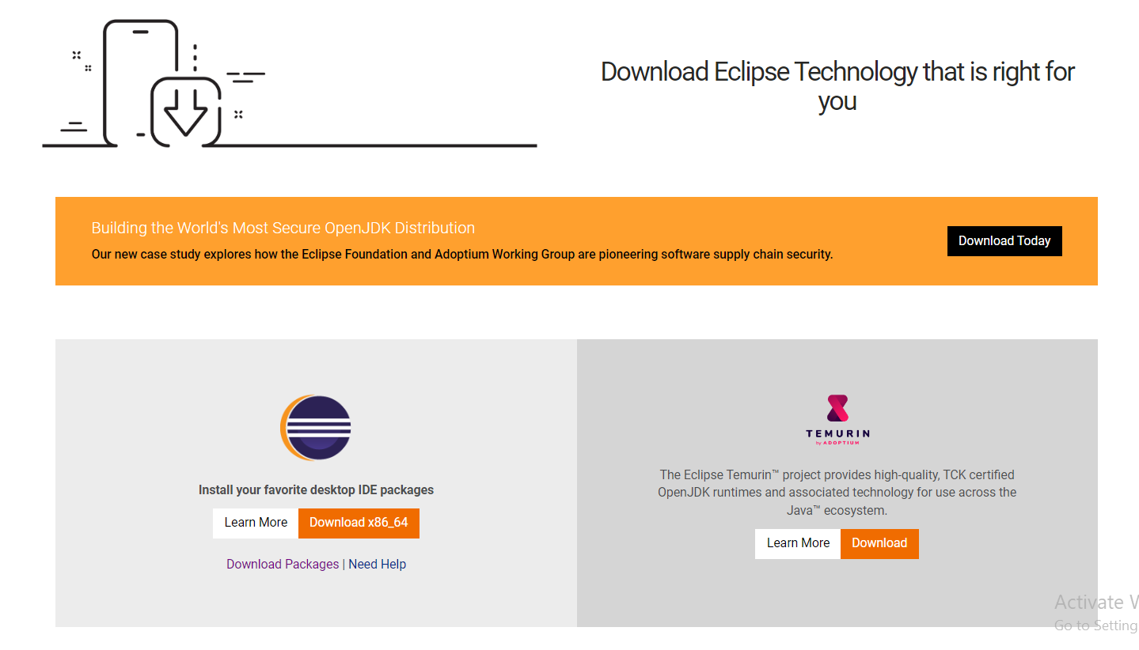
Eclipse IDE
Introduction to Java
Eclipse download page
Click Download packages

Slide 31
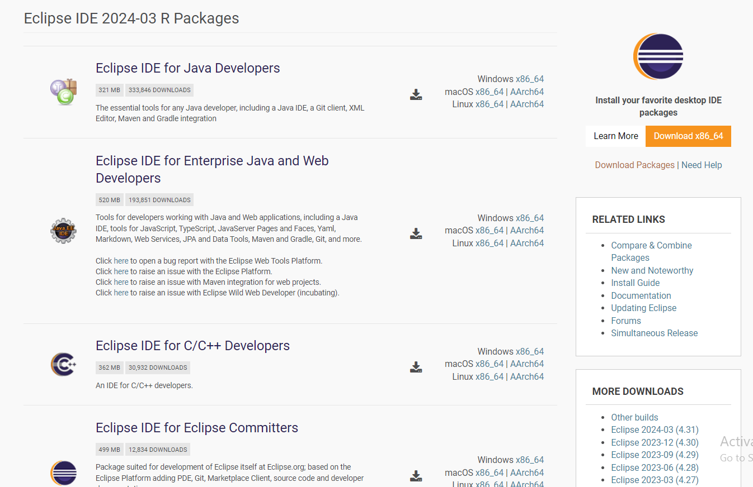
Eclipse IDE
Introduction to Java
Choose an option from the list
Download this package
Other Versions to download from here

Slide 32
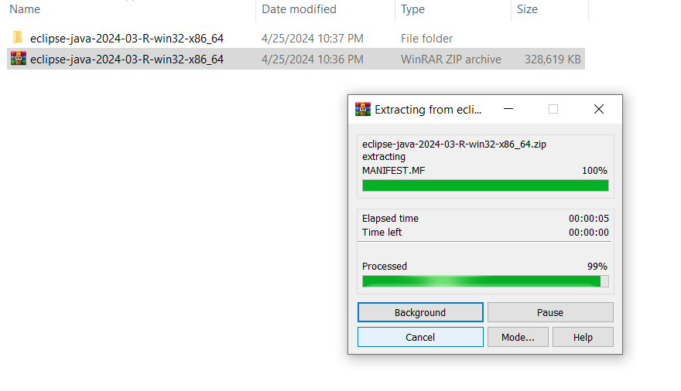
Eclipse IDE
Introduction to Java
After download, right click and extract the eclipse file

Slide 33
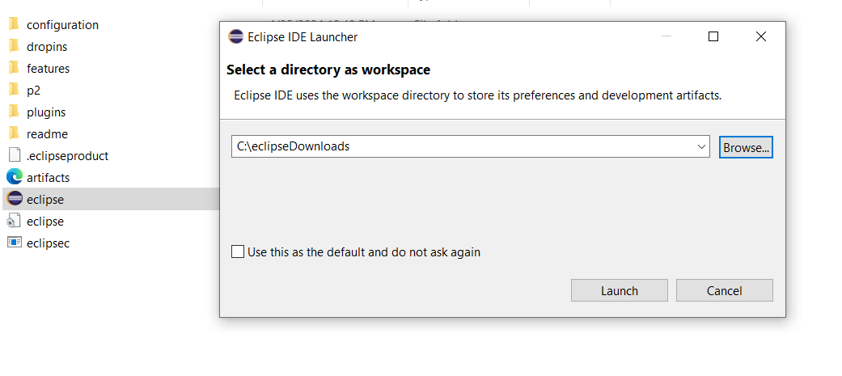
Eclipse IDE
Introduction to Java
Configuring Eclipse: Select a directory to create a workspace for projects

Slide 34
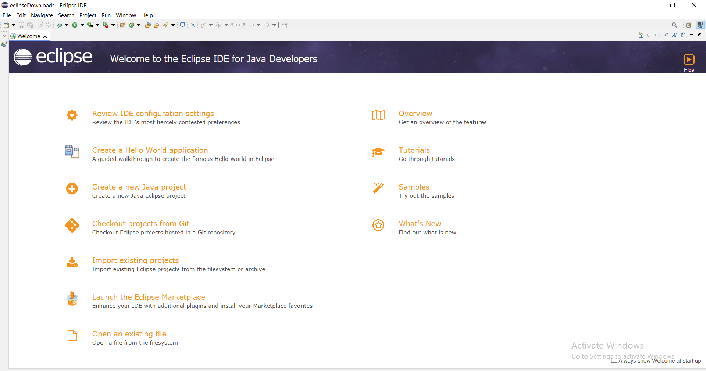
Eclipse IDE
Introduction to Java
Once the workspace is chosen, you will get the welcome page

Slide 35
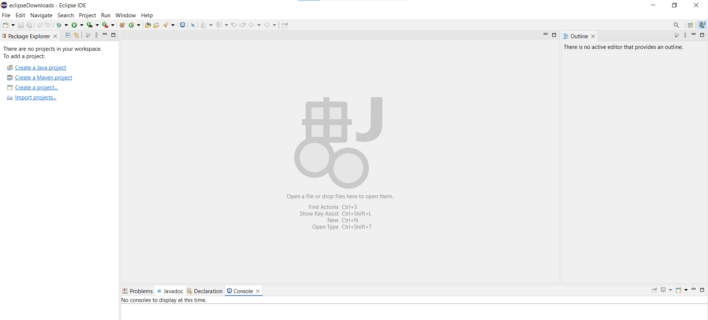
Eclipse IDE
Introduction to Java
After closing the welcome screen ,the project explorer and other options will be shown up.
Now you are ready to start working.

Slide 36
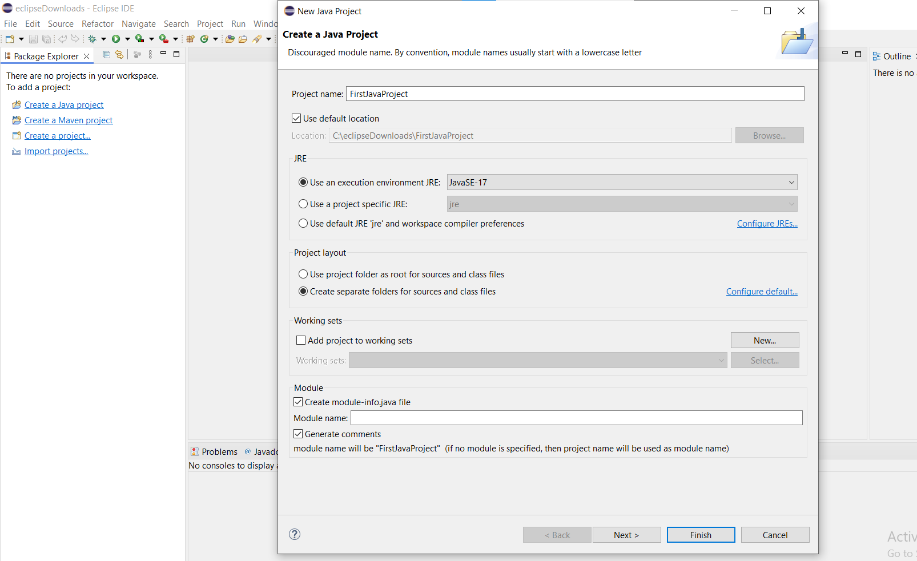
Eclipse IDE
Introduction to Java
Start working by creating the Java Project as FirstJavaProject

Slide 37
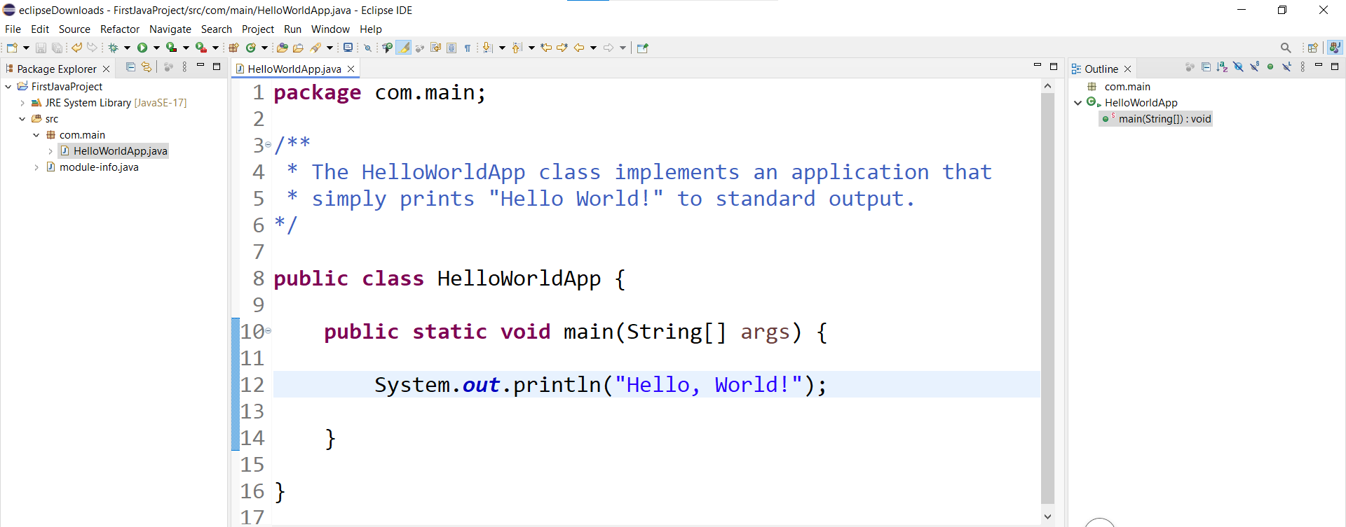
Eclipse IDE
Introduction to Java
Create First Java Program with file extension .java Example: HelloworldApp.java

Slide 38
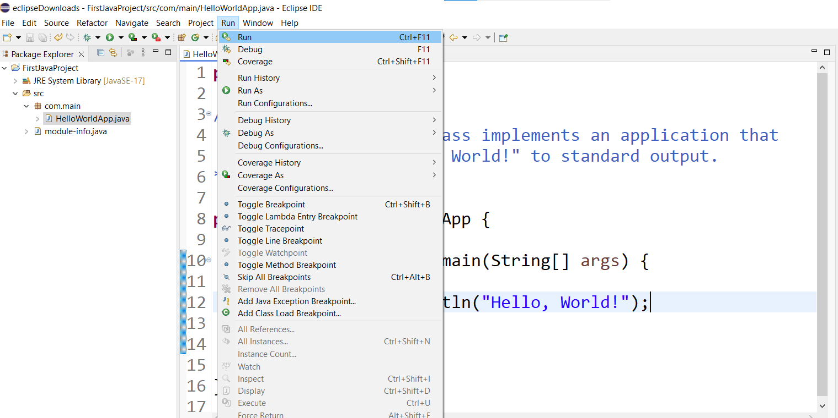
Eclipse IDE
Introduction to Java
After creating the application, run the application with a run command

Slide 39
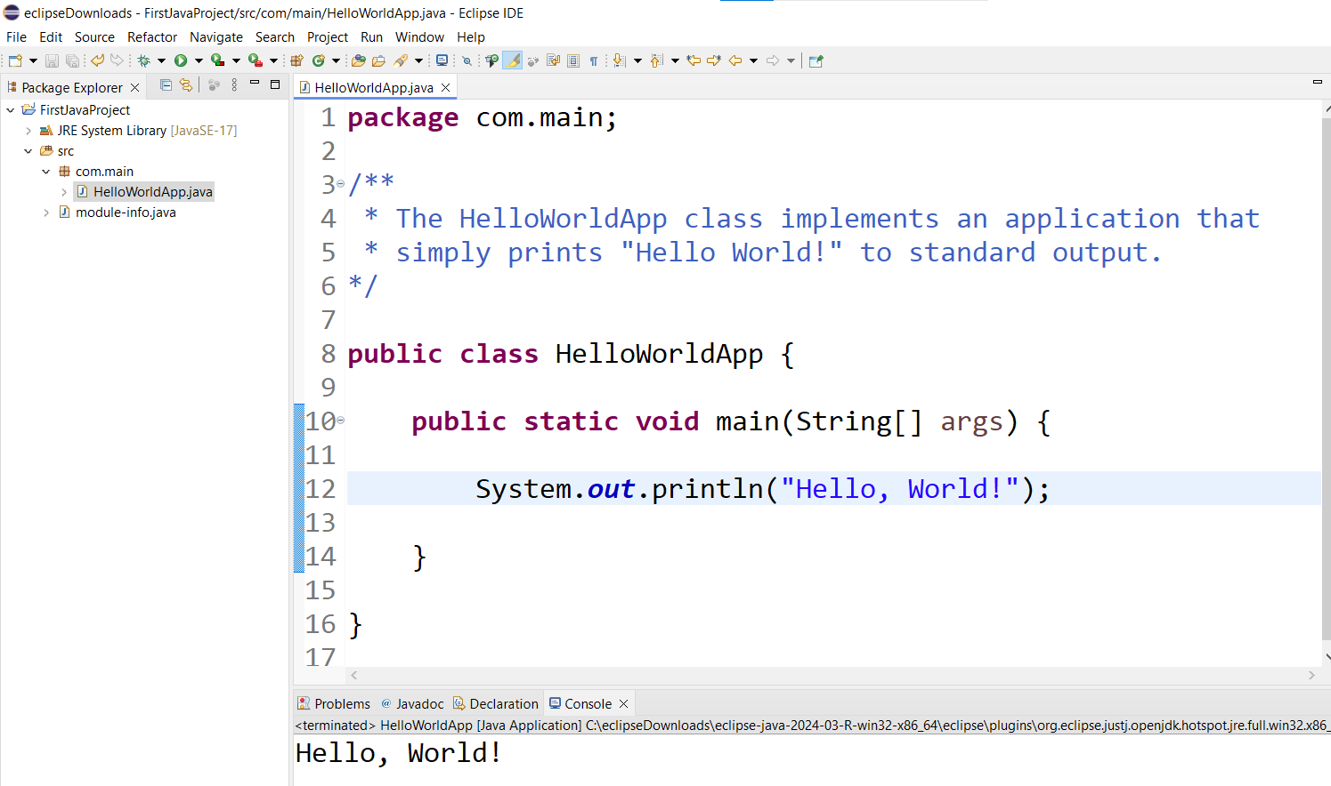
Eclipse IDE
Introduction to Java
After execution, in the console, the output is displayed as Hello World!

Slide 40
First Java Program
Introduction to Java
/** * The HelloWorldApp class implements an application that * simply prints "Hello World!" to standard output. */ class HelloWorldApp { public static void main(String[] args){ System.out.println("Hello World!"); // Display the Hello World! } }

Slide 41
Need of Coding standards
Introduction to Java
Code conventions are important to the programmer for the following reasons
To facilitate the copying, changing, and maintenance of the code.
To maintain the readability of the code.
Helps to understand the code quickly and thoroughly.
Helps to well package the code when deploying as the product.

Slide 42
General coding practice
Introduction to Java
All code should have the following attribute:
Simplicity: Code should be easily understood and be concise.
Readability: Describe the code with comments and name the Identifiers relative to the objective of the code and ensure other people can understand the code.
Modularity: When there is a need to redo the small fraction of code then practice using the existing or reusing the code.
Efficiency: The code should be fast and economical. When using data files, read a value once and store it in a variable – don’t go back and forward for the same value. Close connections if they are not required. Do not hold onto references to variables if not required, so as not to impose a memory leak.

Slide 43
Java source files
Introduction to Java
Source file of java can be saved with the extension or suffixes “Filename.java”.
Java source file has the following order:
Comments
Package and import statements
Class and interface declaration

Slide 44
Indentation
Introduction to Java
In Java, the exact construction of the indentation is unspecified.
so, set the tabs exactly for every 8 spaces.
The line length should not exceed 80 characters.
When the statement is not fit in a single line, then wrap the lines based on the following principles.
Break the lines after a comma.
Example: public void Cart(string product_name, double cost, int quantity, string description)

Slide 45
Indentation
Introduction to Java
Break the line before an operator.
Prefer higher-level breaks to lower-level breaks.
Align the new line with the beginning of the expression at the same level on the previous line.
If the above rules lead to confusing code or to code that's squished up against the right margin, just indent 8 spaces instead.
Example: //Breaking an arithmetic expression before an operator and outside the parenthesized expression at a high level. Calculation = a*(b + c - d) + 4 * b

Slide 46
Indentation
Introduction to Java
Example: //8 space indentation is used to breaking the if statements if ((condition1 && condition2) || (condition3 && condition4) ||!(condition5 && condition6)) { Method(); }
The ternary expression can be formatted as below:
Variable = Expression1 ? Expression 2 : Expression 3; Variable = Expression1 ? Expression 2 : Expression 3; Variable = Expression1 ? Expression 2 : Expression 3;

Slide 47
Indentation
Introduction to Java
Blank Lines:
Blank lines improve readability.
Two blank lines should always be used in the following circumstances:
- Between sections of a source file.
- Between class and interface definitions
One blank line should always be used in the following circumstances:
- Between methods
- Between the local variables in a method and its first statement
- Before a block or single-line comment.
- Between logical sections inside a method.

Slide 48
Indentation
Introduction to Java
Blank Spaces:
Black Spaces are used to improve the reliability of the code and can be used in the following circumstances
A keyword followed by a parenthesis should be separated by a space.
It should not be used between a method name and its opening parenthesis. This helps to distinguish keywords from method calls.
This can be included after commas in an argument list.
Example: while (false){ }

Slide 49
Indentation
Introduction to Java
Except ‘.’ and unary operators all the binary operators should be separated their operands by spaces.
Expression in the for statement should be separated using space.

Slide 50
Comments
Introduction to Java
Comments are the overview or description of the code.
In Java, the comments can be implemented in four styles as follows
Block comments:
Block comments (/***/) are used to provide descriptions of files, methods, data structures, and algorithms.
Block comments may be used at the beginning of each file and before each method and also within methods.
Block comments inside a function or method should be indented to the same level as the code they describe.
Example: /* *Here is a block comment */

Slide 51
Comments
Introduction to Java
Single-Line comments:
A short description of a block of code can be given using single-line comments (/*..*/).
If a comment can't be written in a single line, it should follow the block comment format.
Example: if(condition) { /* Description about bock of code in a single line */ }

Slide 52
Comments
Introduction to Java
Trailing comments:
Trailing comments (/*..*/) are very short comments that describe the statements.
These comments can be included in the same line of the statement but should be separated
from the statement using spaces.
If more than one short comment appears in a code, they should all be indented to the same tab.
Example: class HelloWorldApp { public static void main(String[] args) { System.out.println("Hello World!"); /* Display the Hello World! */ } }

Slide 53
Comments
Introduction to Java
End - Of - Line comments:
This comment line (//) can be used as a single-line comment or a short comment for a statement.
These comments can be included in the same line of the statement but should be separated from the
statement using spaces.
This can be used in consecutive multiple lines for commenting out sections of code.
Example: class HelloWorldApp { public static void main(String[] args) { System.out.println("Hello World!"); // Display the Hello World! } }

Slide 54
Documentation Comments
Introduction to Java
Documentation comments are generally used when writing code for a project/software package.
It helps to generate a documentation page for reference, which can be used for getting information about the present method, its parameters, class, variables, etc..,
The JavaDoc tool is used to process the doc comments that come with JDK and it is used for generating Java code documentation in HTML(HyperText Markup Language) format from Java source code, which requires documentation in a predefined format.
It is made up of two parts: a description and Javadoc tags.

Slide 55
Documentation Comments
Introduction to Java
Javadoc Tag:
Special tag embedded within a Java doc comment.
These doc tags enable you to autogenerate a complete, well-formatted API from your source code.
The tags start with an "at" sign (@) and are case-sensitive (i.e).,they must be in upper and lowercase letters as shown in the below table.
A tag must start at the beginning of a line (after any leading spaces and an optional asterisk) or it is treated as normal text.
By convention, tags with the same name are grouped together.

Slide 56
Documentation Comments
Introduction to Java
Two Types of Javadoc tag :
Block tags - Can be placed only in the tag section that follows the main description.
- Example: @tag
Inline tags - Can be placed anywhere in the main description or in the comments for block tags and Inline tags are denoted by curly braces
- Example: {@tag}

Slide 57
Documentation Comments
Introduction to Java
Javadoc Tags:
Below table describe the Javadoc tag that is used in documentation comments.
Tag | Description | Syntax
@author | Adds the author of a class. | @author name-text
{@code} | Displays text in code font without interpreting the text as HTML markup or nested javadoc tags. | {@code text}
{@docRoot} | Represents the relative path to the generated document's root directory from any generated page. | {@docRoot}
@deprecated | Adds a comment indicating that this API should no longer be used. | @deprecated deprecatedtext
@exception | Adds a Throws subheading to the generated documentation, with the classname and description text. | @exception class-name description

Slide 58
Documentation Comments
Introduction to Java
Tag | Description | Syntax
{@inheritDoc} | Inherits a comment from the nearest inheritable class or implementable interface. | Inherits a comment from the immediate surperclass.
{@link} | Inserts an in-line link with the visible text label that points to the documentation for the specified package, class, or member name of a referenced class. | {@link package.class#member label}
{@linkplain} | Identical to {@link}, except the link's label is displayed in plain text than code font. | {@linkplain package.class#member label}
@param | Adds a parameter with the specified parameter-name followed by the specified description to the "Parameters" section. | @param parameter-name description
@return | Adds a "Returns" section with the description text. | @return description

Slide 59
Documentation Comments
Introduction to Java
Tag | Description | Syntax
@see | Adds a "See Also" heading with a link or text entry that points to reference. | @see reference
@serial | Used in the doc comment for a default serializable field. | @serial field-description | include | exclude
@serialData | Documents the data written by the writeObject( ) or writeExternal( ) methods. | @serialData data-description
@serialField | Documents an ObjectStreamField component. | @serialField field-name field-type field-description
@since | Adds a "Since" heading with the specified since-text to the generated documentation. | @since release
@throws | The @throws and @exception tags are synonyms. | @throws class-name description

Slide 60
Documentation Comments
Introduction to Java
Tag | Description | Syntax
{@value} | When {@value} is used in the doc comment of a static field, it displays the value of that constant. | {@value package.class#field}
@version | Adds a "Version" subheading with the specified version-text to the generated docs when the -version option is used. | @version version-text

Slide 61
Documentation Comments
Introduction to Java
Format of Documentation comments.
Each line above is indented to align with the code below the comment.
The first line contains the begin-comment delimiter (/**).
Write the first sentence as a short summary of the method, as Javadoc automatically places it in the method summary table (and index).
The inline tag can be used anywhere that a comment can be written, such as in the text following block tags.

Slide 62
Documentation Comments
Introduction to Java
If we have more than one paragraph in the doc comment, separate the paragraphs with a <p> paragraph tag.
Insert a blank comment line between the description and the list of tags.
The first line that begins with an "@" character ends the description.
There is only one description block per doc comment; we cannot continue the description following block tags.
The last line contains the end-comment delimiter (*/).

Slide 63
First Java Program using Documentation Comments
Introduction to Java
/** * The HelloWorldApp class implements an application that * simply prints "Hello World!" to standard output. * @author SmartCliff */ class HelloWorldApp { public static void main(String[] args) { System.out.println("Hello World!"); // Display the Hello World! } }
Doc comment

Slide 64
First Java Program in Detail
Introduction to Java
Class: keyword is used to declare a class in java.
public keyword is an access modifier which represents visibility, it means it is visible to all.
static is a keyword, if we declare any method as static, it is known as static method.
The core advantage of static method is that there is no need to create object to invoke the static method.
The main method is executed by the JVM, so it doesn't require to create object to invoke the main method. So it saves memory.
void is the return type of the method, it means it doesn't return any value.

Slide 65
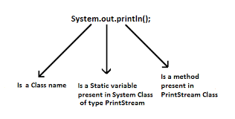
First Java Program in Detail
Introduction to Java
main represents startup of the program.
String[] args is used for command line argument.
System.out.println() is used print statement.
- System is a final class defined in the java.lang package.

Slide 66
Package: Introduction
Introduction to Java
Package: It is a mechanism to organize related classes, interfaces, and sub-packages according to their functionality. It is like a folders in a file directory.
Java Package
Sub-Packages (lang, io, util, etc.,) interfaces
Each sub-packages have lot of related classes
Each class have lot of methods

Slide 67
Package: Introduction
Introduction to Java
There are two types of Packages:
1. Built-in Packages: The already defined package in Java API like java.io.*, java.lang.* etc. are known as built-in packages. It is simply import based on your application needs.
2. User-defined Packages: The package created by user and use based on application needs is called user-defined package.
Note:
Programmers typically use packages to organize classes belonging to the same category or providing similar functionality.

Slide 68
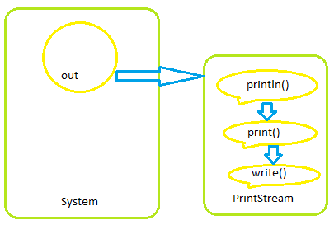
Package: Introduction
Introduction to Java
Example: java.lang.System (System class is a one of the class of lang package)
Note:
As per Java 1.8 standard version, Java have 14 predefined packages, 150 sub packages, 7000 classes and 7 lakh methods.

Slide 69
Compiling and Executing
Introduction to Java
To run java application both compiler and interpreter involves.
The source code of Java will be created with file extension .java, Example: HelloworldApp.java
The java Compiler compiles a java file and convert into bytecode / classfile.
The byte code will be in a file with extension .class
The .class file is interpreted by the JVM and morphed into machine specific code.

Slide 70
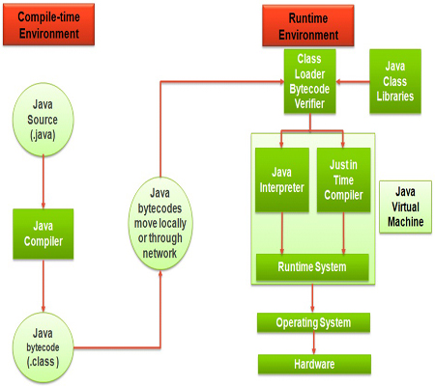
Compiling and Executing
Introduction to Java

Slide 71
Just-In-Time (JIT) Compiler
Introduction to Java
The Just-In-Time (JIT) compiler is one of the integral parts of the Java Runtime Environment.
It improves the performance of Java applications by compiling byte codes to native machine code at run time.
The JIT compiler is enabled by default. When a method has been compiled, the JVM calls the compiled code of that method directly instead of interpreting it.
Theoretically, if compilation did not require processor time and memory usage, compiling every method could allow the speed of the Java program to approach that of a native application.

Slide 72
Java Tokens
Please download pictures in suitable size here and insert them by clicking the symbol above.

Slide 73
Introduction
Java Tokens
The tokens are the small building blocks of a Java program that are meaningful to the Java compiler.
The Java compiler breaks the line of code into text (words) is called Java tokens.
The Java compiler identified these words as tokens.
These tokens are separated by the delimiters and delimiters are not part of the Java tokens.
It is useful for compilers to detect errors.
Example: In program, we will be using many statements and expressions to perform the operation. These
statements and expressions are made up of tokens.

Slide 74
Introduction
Java Tokens
Java supports 5 types of tokens as follows:
1. Keywords
2. Identifiers
3. Literals
4. Operators
5. Special symbols

Slide 75
Keywords
Java Tokens
Keywords are predefined or reserved words that have special meaning to the Java compiler.
Each keyword is assigned a special task or function and cannot be changed by the user.
We cannot use keywords as variables or identifiers as they are a part of Java syntax itself.
A keyword should always be written in lowercase as Java is a case-sensitive language.

Slide 76
Keywords
Java Tokens
They are some available keywords in Java
Keywords
abstract | continue | for | new | switch
assert | default | goto | package | synchronized
boolean | do | if | private | this
break | double | implements | protected | throw
byte | else | import | public | throws
case | enum | instanceof | return | transient
catch | extends | int | short | try
char | final | interface | static | void
class | finally | long | strictfp | volatile
const | float | native | super | while

Slide 77
Identifiers
Java Tokens
An identifier is the name given by the user for the various programming elements like variables, classes, methods, interface, etc.
Rules for defining Identifiers
Allowed characters for identifiers are all alphanumeric characters([A-Z],[a-z],[0-9]), ‘$‘(dollar sign) and ‘_‘ (underscore).
Example: “blue@” is not a valid as it contain ‘@’ special character.
Identifiers should not start with digits([0-9]).
Example: “123blue” is a not a valid
Java identifiers are case-sensitive.
Example: test and Test both are different

Slide 78
Identifiers
Java Tokens
There is no limit on the length of the identifier, but it is advisable to use an optimum length of 4 – 15 letters only.
Reserved Words can’t be used as an identifier.
Example: int while = 20; is an invalid statement as while is a reserved word.
Some Valid Identifiers Some Invalid Identifiers
test, Test, _name, name100 int, 100name, test@123
ABC, File_100, _abc_ Test.txt,

Slide 79
Naming Convention of Identifiers
Java Tokens
All the identifiers such as classes, interfaces, packages, methods, and fields of Java programming language are given according to the Java naming convention.
By using this naming convention, we can achieve readability and can also easily understand the code.
In programming, we often remove the spaces between words because programs of different sorts reserve the space (‘ ’) character for special purposes.
Because the space character is reserved, we cannot use it to represent a concept that we express in our human language with multiple word

Slide 80
Naming Convention: Identifiers
Java Tokens
Example
That is in programming we cannot refer, user login count=5.
We can represent as userLoginCount=5.
Java follows the CamelCase for identifiers naming conventions.
CamelCase
- Combines the compound words and removes the space between the words.
- Two types: UpperCamelCase and lowerCamelCase.
- UpperCamelCase: The first letter of each word is capitalized.
Example: Product, ProductDescription, CountValue.
- LowerCamelCase: The first letter of the compound words is lowercase.
Example: product, iPad, countValue, productDescription

Slide 81
Naming Convention : Variables
Java Tokens
A variable's name can be any legal identifier i.e., begins with a letter, the dollar sign "$", or the underscore character “_“.
The variable name should be short and meaningful.
The choice of a variable name should be mnemonic- that is, designed to indicate to the casual observer the intent of its use.
One-character variable names should be avoided except for temporary variables.
The temporary variables can be i,j,k,m, and n for integer and c,d,e for characters.
The variable name should be in lowerCamelCase.
Example: String firstName; int orderNumber ; int count; float price;

Slide 82
Naming Convention : Variables
Java Tokens
Private class variables should have an underscore prefix.
Apart from its name and its type, the scope of a variable is its most important feature.
Indicating class scope by using underscore makes it easy to distinguish class variables from local scratch variables.
This is important because class variables are considered to have higher significance than method variables, and should be treated with special care by the programmer
Example: class Login{ private String _userName; … }

Slide 83
Naming Convention : Constants and Methods
Java Tokens
Constants:
The names of variables declared class constants and should be in uppercase.
If we specify the constant with two words, then separated by underscores ("_").
Example: static final int MAX_HEIGHT = 70; static final int MAX_WIDTH = 100; static final int LENGTH = 20;

Slide 84
Naming Convention : Constants and Methods
Java Tokens
Methods
Method should be in the verb.
Method name should be lowerCamelCase.
Example: void calculateTax() String getSurname() void draw()

Slide 85
Naming Convention : Package and Import statements
Java Tokens
The first non-comment line of the java source file is a package followed by import statements.
The prefix of a unique package name is always written in all-lowercase ASCII letters.
Example: package java.util.*; import java.util.Scanner;

Slide 86
Naming Convention: Class and interface
Java Tokens
Class names should be nouns and must be simple and descriptive.
Use whole words-avoid acronyms and abbreviations.
Class name should be in UpperCamelCase.
Example: class Customer class CustomerAccount class Login

Slide 87
Naming Convention: Class and interface
Java Tokens
Interface tends to have a name that describes an operation that a class can do.
Name of the interface should be UpperCamelCase.
Example: interface Enumerable interface CompEnumerable interface Login

Slide 88
Data Types
Java Tokens
Data types defines the type data a variable can hold. It specify the different sizes and values that can be stored in the variable.
Java is a strongly typed language
All variables must be declared before its use.
Two Types of Data types
Primitive data type
byte, short, in, long, float, double, char, boolean
Non Primitive data type
- Classes, interfaces, arrays, strings

Slide 89
Data Types
Java Tokens
byte: (1 byte):
The byte data type is an 8-bit signed two's complement integer.
It has a minimum value of -128 and a maximum value of 127 (inclusive).
Useful for saving memory in large arrays.
Default value : 0
short: (2byte)
The short data type is a 16-bit signed two's complement integer.
It has a minimum value of -32,768 and a maximum value of 32,767 (inclusive).As byte ,can use a short to save memory in large arrays
Default value : 0

Slide 90
Data Types
Java Tokens
int: (4 byte)
By default, the int data type is a 32-bit signed two's complement integer, which has a minimum value of -2³¹ and a maximum value of 2³¹ -1.
Default value : 0
long: (8 byte)
The long data type is a 64-bit two's complement integer.
The signed long has a minimum value of -2⁶³ and a maximum value of 2⁶³-1
Default value : 0L
float: (4 byte)
The float data type is a single-precision 32-bit IEEE 754 floating point.
Default value : 0.0f

Slide 91
Data Types
Java Tokens
double: (8 byte)
The double data type is a double-precision 64-bit IEEE 754 floating point
Default value : 0.0d
boolean: (1 bit)
The boolean data type has only two possible values: true and false
Default value : false
char: (2 byte)
single 16-bit Unicode character. It has a minimum value of '\u0000' (or 0) and a maximum value of '\uffff‘
Default value : '\u0000'

Slide 92
Variables
Java Tokens
A symbolic name associated with a value and whose associated value may be changed.
A variable is defined by the combination of an identifier, a type and an optional initializer.
All variables have a scope, which defines their visibility, and a lifetime.
There are three types of variables:
Local Variables
Instance Variables (Non-Static Fields)
Class Variables (Static Fields)

Slide 93
Variables
Java Tokens
Local Variables
Variable that's declared within the body of a method.
Will be used only within that method.
Other methods in the class aren't even aware that the variable exists.
A method will often store its state in local variables.
A local variable cannot be defined with "static" keyword.

Slide 94
Variables
Java Tokens
Instance Variables (Non-Static Variables)
A variable declared inside the class but outside the body of the method, is called instance variable.
It is not declared as static.
Instance variables are created when the objects are instantiated and therefore they are associated with the objects.

Slide 95
Variables
Java Tokens
Class Variables (Static Variables) :
A variable which is declared as static is called static variable. It is also called as a class variable
It cannot be local.
You can create a single copy of static variable and share among all the instances of the class.
Memory allocation for static variable happens only once when the class is loaded in the memory.

Slide 96
Variables
Java Tokens
/** * The VariableApp class implements an application that * illustrate different Java variable */ class VariableApp { int mark = 95 ;//instance variable static char grade = ‘S’; // static variable public static void main(String[] args) { float average=95.0 // local variable } }

Slide 97
Literals
Java Tokens
A fixed value assigned to a variable
Different types of literals are as follows:
Types | Examples
Integer Literals Decimal Hexa Decimal Binary | int decValue=56; int hexaValue=0x10; int binVal=0b11010 ;
Floating-Point Literals | double d1 = 123.4; double d2 = 1.234e2; float f1 = 123.4f;
Character Literals | char chrlit=‘0108’;
String Literals | String check=“Test” ;
Boolean Literals | boolean result=true;

Slide 98
Literals
Java Tokens
Using Underscore Characters in Numeric Literals
In Java SE 7 and later, any number of underscore characters (_) can appear anywhere between digits in a numerical literal.
Enables to separate groups of digits in numeric literals, which can improve the readability of your code.
Example:
long creditCardNumber = 1234_5678_9012_3456L;
long socialSecurityNumber = 999_99_9999L;
long bytes = 0b11010010_01101001_10010100_10010010;

Slide 99
Literals
Java Tokens
You can place underscores only between digits; you cannot place underscores in the following places:
At the beginning or end of a number
Adjacent to a decimal point in a floating point literal
Prior to an F or L suffix
In positions where a string of digits is expected

Slide 100
Unicode
Java Tokens
It is Computing industry standard designed to encode characters of the world's written languages.
Unicode System?
Before Unicode, there were many language standards:
ASCII (American Standard Code for Information Interchange) for the United States.
ISO 8859-1 for Western European Language.
KOI-8 for Russian.
GB18030 and BIG-5 for Chinese, and so on.

Slide 101
Unicode
Java Tokens
Problems:
A particular code value corresponds to different letters in the various language standards.
The encodings for languages with large character sets have variable length.
Some common characters are encoded as single bytes, other require two or more byte.
Solution:
To solve these problems, a new language standard was developed i.e. Unicode System.
In Unicode, character holds 2 byte, so java also uses 2 byte for characters.
The range of a char is 0 to 65,536

Slide 102
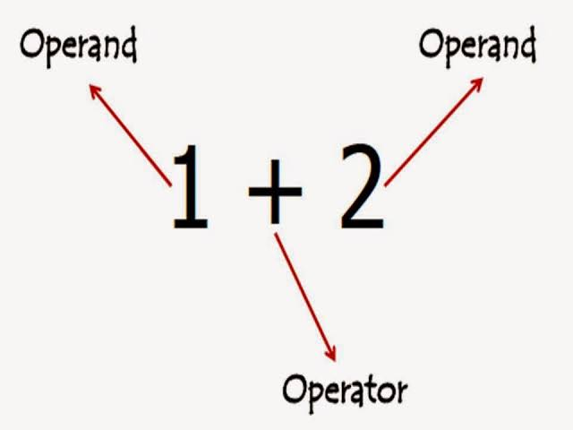
Operators
Java Tokens
An operator in Java is a special symbol that signifies the compiler to perform some specific mathematical or non-mathematical operations on one or more operands.
Value that the operator operates on is called operand.
Java supports 8 types of operators.

Slide 103
Expression
Java Tokens
An expression in Java is any valid combination of tokens like variables, constants and operators.
An expression may consist of one or more operands, and zero or more operators to produce a value.
Examples:
- a + b * c
- (a * b) / (c + d)
- 10 – 4 * 5
- Etc.,

Slide 104
Operators & Expressions
Java Tokens
Below table we have listed down all the operators, along with their expressions:
Type | Operators | Expressions
Unary Operator | ++,--,+(unary),-(unary), ~,! | a++,--a, -a, ~a, !a
Arithmetic Operator | +,-,%,*,/ | a=b+c, a=b%d
Shift Operator | <<,>>,>>> | a=a>>2
Relational Operator | >,>=,<,<=,==, !=,instance of | a=10>5,5!=10,8==8
Bitwise Operator | &,^,| | a=2&3
Logical Operator | &&,|| | (2>5)&&(10>8)
Ternary Operator | ? : | a=(b>c)?1:0
Assignment Operator | = ,+=, -=, *= ,/= ,%= .&= ,^= ,|= <<= ,>>=,>>> | a=b a+=b a^=b

Slide 105
Precedence and Associativity
Java Tokens
Precedence
Operator precedence determines the order in which the operators in an expression are evaluated.
Associativity
If an expression has two operators with similar precedence, the expression is evaluated according to its associativity.
That is either left to right or right to left.
Example: int num = 6 -3 *8;
To evaluate the above expression Java, consider the precedence of the operator. Here, Multiplication (*) has the highest precedence over subtraction (-). So multiplication will be performed before the subtraction.
Example: X=Y=Z; Operator has same precedence. Here, the value of Z is assigned to variable Y. Then the value of Y is assigned of variable X because the associativity of = operator is from right to left

Slide 106
Precedence and Associativity
Java Tokens
Operators | Precedence | Associativity
postfix increment and decrement | ++ -- | left to right
prefix increment and decrement, and unary | ++ -- + - ~ ! | right to left
multiplicative | * / % | left to right
additive | + - | left to right
shift | << >> >>> | left to right
relational | < > <= >= instanceof | left to right
equality | == != | left to right

Slide 107
Precedence and Associativity
Java Tokens
Operators | Precedence | Associativity
bitwise AND | & | left to right
bitwise exclusive OR | ^ | left to right
bitwise inclusive OR | | | left to right
logical AND | && | left to right
logical OR | || | left to right
ternary | ? : | right to left
assignment | = += -= *= /= %= &= ^= |= <<= >>= >>>= | right to left

Slide 108
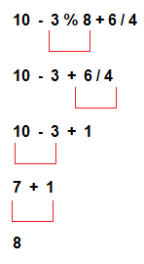
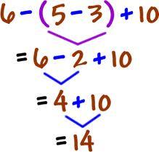
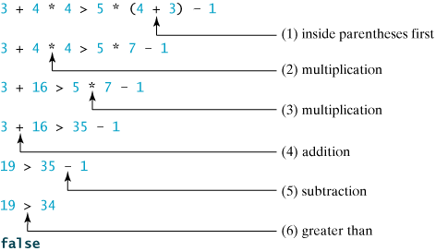
Expression Evaluation
Java Tokens
Example 1 : 10 – 3 % 8 + 6 / 4
Example 2: 6 - ( 5 – 3 ) + 10
Example 3 : 3+4*4>5*(4+3) -1

Slide 109
BITWISE OPERATOR
Please download pictures in suitable size here and insert them by clicking the symbol above.

Slide 110
Introduction
Bitwise Operator
Bitwise operators are used to perform operations at the bit level and help to manipulate data at the bit level which we can call bit-level programming.
Bit-level programming contains 0 and 1.
These can be done by first converting a decimal value to its binary form. This binary form is nothing but a sequence of bits. Bitwise operators perform operations on these bits.

Slide 111
Types
Bitwise Operator
There are 6 bitwise operators in Java language. They are
Operator | Meaning
& | Bitwise AND operator
| | Bitwise OR operator
^ | Bitwise exclusive OR operator
~ | Binary One’s Complement Operator
<< | Left shift operator
>> | Right shift operator

Slide 112
Types : AND(&)
Bitwise Operator
The bitwise AND operator is denoted using a single ampersand symbol,(&) and it needs two operands to work on.
It takes the binary values of both the left and right operands and performs the logical AND operation over them on the bit level, i.e. if both the operands have 1 on the specified position then the result will also have 1 in the corresponding position or else there will be 0.
Num1 | Num2 | Result=Num1 & Num2
0 | 0 | 0
1 | 0 | 0
0 | 1 | 0
1 | 1 | 1
Truth table for Bitwise AND operator

Slide 113
Types : AND(&)
Bitwise Operator
Example: Let's take a look at the bitwise AND operation of two integers 12 and 25.
Now move from left to right, and perform logical AND operations on the bits, and store the result in the corresponding position.
12 = 00001100 (In Binary)
25 = 00011001 (In Binary)
// Bitwise AND Operation of 12 and 25
00001100
& 00011001
____________
00001000 = 8 (In Decimal)

Slide 114
Types : AND(&)
Bitwise Operator
// Bitwise AND
class Main {
public static void main(String[] args) {
int number1 = 12, number2 = 25, result;
// bitwise AND between 12 and 25
result = number1 & number2;
System.out.println(result); // prints 8
}
}
Output: 8

Slide 115
Types : OR(|)
Bitwise Operator
The bitwise OR operator is much similar to the bitwise AND, i.e. if at least any one of the operands has 1, then the result will also have 1 in the corresponding position, and 0 if they both have 0 in the corresponding position.
This is denoted using the vertical bar or pipe symbol, i.e. |.
Num1 | Num2 | Result=Num1 | Num2
0 | 0 | 0
1 | 0 | 1
0 | 1 | 1
1 | 1 | 1
Truth table for Bitwise OR operator

Slide 116
Types : OR(|)
Bitwise Operator
Example: Let's take a look at the bitwise OR operation of two integers 12 and 25.
Now move from left to right, and perform logical OR operations on the bits, and store the result in the corresponding position.
12 = 00001100 (In Binary)
25 = 00011001 (In Binary)
Bitwise OR Operation of 12 and 25
00001100
| 00011001
____________
00011101 = 29 (In Decimal)

Slide 117
Types : OR(|)
Bitwise Operator
// Bitwise OR
class Main {
public static void main(String[] args) {
int number1 = 12, number2 = 25, result;
// bitwise OR between 12 and 25
result = number1 | number2;
System.out.println(result); // prints 29
}
}
Output: 29

Slide 118
Types : XOR(^)
Bitwise Operator
This is similar to the other two, but the only difference is that they perform logical XOR on the bit level, i.e., if exactly one of the operands has 1 and the other has 0 then the result will have 1 in the corresponding position, and 0 if they have the same bits such as both 0s or both 1s.
Num1 | Num2 | Result=Num1 ^ Num2
0 | 0 | 0
1 | 0 | 1
0 | 1 | 1
1 | 1 | 0
Truth table for Bitwise XOR operator

Slide 119
Types : XOR(^)
Bitwise Operator
Example: Let's take a look at the bitwise OR operation of two integers 12 and 25.
Now move from left to right, and perform logical AND operations on the bits, and store the result in the corresponding position.
12 = 00001100 (In Binary)
25 = 00011001 (In Binary)
// Bitwise XOR Operation of 12 and 25
00001100
^ 00011001
____________
00010101 = 21 (In Decimal)

Slide 120
Types : XOR(^)
Bitwise Operator
// Bitwise XOR
class Main {
public static void main(String[] args) {
int number1 = 12, number2 = 25, result;
// bitwise XOR between 12 and 25
result = number1 ^ number2;
System.out.println(result); // prints 21
}
}
Output: 21

Slide 121
Types : Complement (~)
Bitwise Operator
We have seen three bitwise so far, if you have noticed, all of them were [binary i.e. they all require two operands to perform their functions.
But complement operator (~), is the only bitwise operator that requires only one operand.
The bitwise complement operator takes a single value and returns the one’s complement of the value.
The one’s complement of a number is obtained by changing all the 0’s in its binary value to 1’s and by changing the 1’s to 0’s.
Num1 | Result=Num1 ^ Num2
0 | 1
1 | 0
Truth table for Bitwise Complement operator

Slide 122
Types : Complement (~)
Bitwise Operator
It is important to note that the bitwise complement of any integer N is equal to - (N + 1).
For example :Consider an integer 35. As per the rule, the bitwise complement of 35 should be -(35 + 1) = -36. Now let's see if we get the correct answer or not.
35 = 00100011 (In Binary)
// using bitwise complement operator
~ 00100011
__________
11011100

Slide 123
Types : Complement (~)
Bitwise Operator
In the above example, we get that the bitwise complement of 00100011 (35) is 11011100. Here, if we convert the result into decimal we get 220.
However, it is important to note that we cannot directly convert the result into decimal and get the desired output. This is because the binary result 11011100 is also equivalent to -36.
To understand this we first need to calculate the binary output of -36.
2's Complement
In binary arithmetic, we can calculate the binary negative of an integer using 2's complement.
1's complement changes 0 to 1 and 1 to 0. And, if we add 1 to the result of the 1's complement, we get the 2's complement of the original number. Example as Follows

Slide 124
Types : Complement (~)
Bitwise Operator
// compute the 2's complement of 36
36 = 00100100 (In Binary)
1's complement = 11011011
2's complement:
11011011
+ 1
_________
11011100
Here, we can see the 2's complement of 36 (i.e. -36) is 11011100. This value is equivalent to the bitwise complement of 35.Hence, we can say that the bitwise complement of 35 is -(35 + 1) = -36.

Slide 125
Types : Complement (~)
Bitwise Operator
// Bitwise Complement
class Main {
public static void main(String[] args) {
int number = 35, result;
// bitwise complement of 35
result = ~number;
System.out.println(result); // prints -36
}
}
Output: -36

Slide 126
Types : Shift Left (<<)
Bitwise Operator
The left shift operator (<<) is a bitwise operator that shifts the bits of a binary number to the left by a specified number of positions.
In other words, it multiplies the number by 2 raised to the power of the shift count.
Here's how the left shift operation works:
Each bit in the binary representation of the number is shifted to the left by the specified number of positions.
The vacant positions on the right are filled with zeros.
The leftmost bits that are shifted out (if any) are discarded.

Slide 127
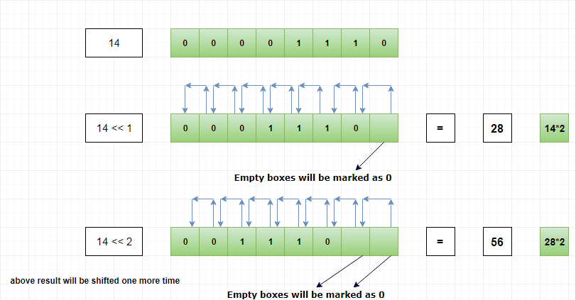
Types : Shift Left (<<)
Bitwise Operator
Left Shift Operator
Vacated bit
filled bit

Slide 128
Types : Shift Left (<<)
Bitwise Operator
// Left shift Operators
class Main {
public static void main(String[] args) {
int number = 2;
// 2 bit left shift operation
int result = number << 2;
System.out.println(result); // prints 8
}
}
Output: 8

Slide 129
Types : Shift Right (>>)
Bitwise Operator
The right shift operator (>>) is a bitwise operator that shifts the bits of a binary number to the right by a specified number of positions.
In other words, it divides the number by 2 raised to the power of the shift count, discarding the remainder.
Here's how the right shift operation works:
Each bit in the binary representation of the number is shifted to the right by the specified number of positions.
The vacant positions on the left are filled with the sign bit (for signed integers) or with zeros (for unsigned integers).
The rightmost bits that are shifted out (if any) are discarded.

Slide 130
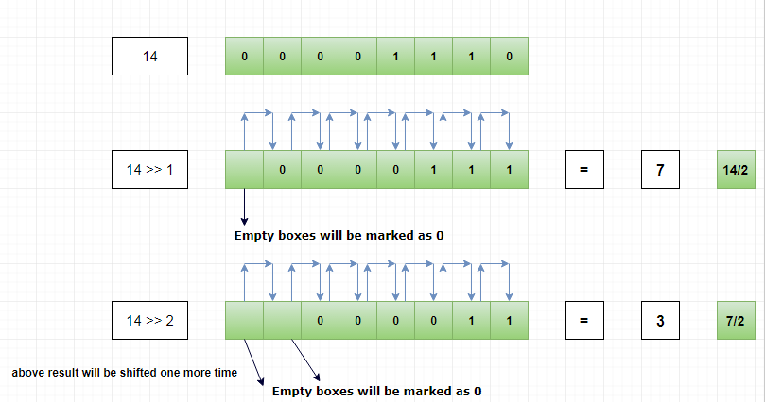
Types : Shift Right (>>)
Bitwise Operator
Right Shift Operator
Vacated bit
filled bit

Slide 131
Types : Shift Right (>>)
Bitwise Operator
// Right shift Operators
public class Main {
public static void main(String[] args) {
int num = 12;
int result = num >> 2;
System.out.printf("Right shift of %d by 2 is %d\n", num, result);
}
}
Output:
Right shift of 12 by 2 is 3
In the example, the value of num is 12, and the result of num >> 2 is 3.
The binary representation of 12 is 0000 1100, and after right-shifting by 2 positions, it becomes 0000 0011, which is 3 in decimal.

Slide 132
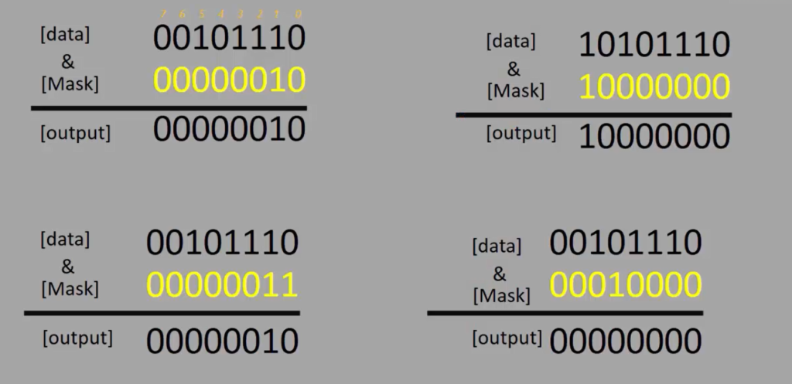
Bit Masking
Bitwise Operator
BIT MASKING: Bit masking is a technique in programming used to test or modify the states of the bits of a given data.
Here we have to decide what should be the Mask_value, and then take that Mask_value and do a bitwisewise operation with a given data to get the output.

Slide 133
Bit Masking
Bitwise Operator
Bit fields in programming are used to pack multiple data fields within a single word or byte, allowing for more efficient use of memory.
Bitwise operators are particularly useful when working with bit fields because they enable manipulation and extraction of specific bits within a bit field.
Here's how bitwise operators can be helpful for bit fields:
1.Setting and Clearing Bits: Bitwise OR (|) is commonly used to set specific bits within a bit field. You can create a mask with the desired bit set to 1 and perform a bitwise OR with the existing value.
Bitwise AND (&) with the complement of a mask can be used to clear specific bits within a bit field.
2. Checking Bit Values: Bitwise AND (&) can be used to check the value of a specific bit within a bit field. If the result is non-zero, the bit is set; otherwise, it is clear.

Slide 134
Bit Masking
Bitwise Operator
3.Toggle Bits: Bitwise XOR (^) can be used to toggle specific bits within a bit field. XORing with a mask toggles the corresponding bits.
4.Extracting Bit Fields: Right shifting (>>) can be used to extract a specific bit field from a larger bit field. By creating a mask with the relevant bits set to 1 and using it in a bitwise AND operation, you can obtain the desired bit field.
5.Combining Bit Fields: Bitwise OR (|) can be used to combine multiple bit fields into a single value. This is useful when you have separate values for different attributes packed into a single variable.

Slide 135
Bit Masking
Bitwise Operator
TESTING OF BITS:
Testing a bit refers to checking the value of a specific bit within a binary representation of a number or data.
In the context of programming and bitwise operations, testing a bit typically involves checking whether a particular bit is set (equal to 1) or clear (equal to 0) within a binary value.
Lets us understand with the below example:
Write a program to find out whether a user entered a number is even or odd. Print an appropriate message on the console
Use testing of bits logic.

Slide 136
Bit Masking
Bitwise Operator
LOGIC:
How this works is, let’s consider a number an integer, let’s say 46.
If you write 46 in binary form, you get 00101110, and here the least significant bit is 0.
For an EVEN number, the LSB is always 0.
Let’s consider the odd number 47. 00101111 is a binary form of 47. Here the least significant bit is 1.
For the ODD number, the LSB will always be 1.
That’s why by checking or by testing the least significant bit(LSB) of a number, we can find out whether a number is even or odd.

Slide 137
Bit Masking
Bitwise Operator
Testing of a bit can be achieved by the technique called Bit-Masking
Bit masking is a technique in programming used to test or modify the states of the bits of a given data.
Here we have to decide what should be the Mask_value, and then take that Mask_value and do a bitwise AND(&) operation with a given data to get the output.
First we need to create a Mask_value: 00101110 is the input number written in a binary format. We divide this number into two areas: area1(0 0 1 0), and area2(1 1 1 0)
46
0 0 1 0 1 1 1 0
Mask_value
0 0 0 0 0 0 0 1
0 0 0 0 0 0 0 0

Slide 138
Bit Masking
Bitwise Operator
To find the even or odd of the number we no need to concentrate on the area1 so we are clearing as (0 0 0 0) and in area 2 we can determine with the LSB bit we set the mask as (0 0 0 1) and performs bitwise AND.
As the result if LSB is 1 denotes the number is ODD or 0 then the number is EVEN.
46
0 0 1 0 1 1 1 0
Mask_value
0 0 0 0 0 0 0 1
0 0 0 0 0 0 0 0

Slide 139
Bit Masking
Bitwise Operator
If( number & 1) is a logic, Here the number is bitwise ANDed with a mask value which is 1.
If(number & 1) this whole expression turns out to be a non-zero value, then the expression will be true. So, in that case, the print number is odd.
If the output of if(number & 1) this expression is false, that is 0, then you can print the number as even.
// Even or ODD using Bitwise operation
if(number & 1)
{
printf (number odd);
}else
{
printf (number even);
}

Slide 140
Bit Masking
Bitwise Operator
SETTING OF BITS:
Setting a bit means changing the value of a specific bit within a binary representation of a number or data to 1.
Let us understand with the below example:
Write a program to set(make bit state to 1), 4th and 7th-bit position of a given number and print the result.

Slide 141
Bit Masking
Bitwise Operator
we have to use a mask value.,where the 4th and 7th bits are set(1).
After that, we have to decide whether you want to use bitwise & operator or bitwise | operator.
What happens if we use bitwise & operator?
00010000 is the result you get.
Here you can see that the output is not correct. We messed up a lot of bits here. So, we messed up with those bits, which we are not supposed to touch. It clearly shows that you cannot use bitwise & operator if you require to set the bits.
That’s why the ‘&’ operator is used to ‘TEST’ not to ‘SET’.
7 6 5 4 3 2 1 0
Data
0 0 1 1 1 1 1 0
Mask_value
1 0 0 1 0 0 0 0
0 0 0 1 0 0 0 0

Slide 142
Bit Masking
Bitwise Operator
What happens if we use bitwise | operator?
10111110 is the result you get.
Here you can see that the output is correct. you get this result 10111110. Here you can see that the un-affected data portion is not affected at the output. They are safe. So, only 4th and 7th-bit positions are set.
bitwise ‘&’ is used to ‘TEST’ not to ‘SET’; bitwise ‘|’ is used to ‘SET’ not to ‘TEST’.
7 6 5 4 3 2 1 0
Data
0 0 1 1 1 1 1 0
Mask_value
1 0 0 1 0 0 0 0
1 0 1 1 1 1 1 0

Slide 143
Bit Masking
Bitwise Operator
CLEARING OF BITS:
Clearing a bit means changing the value of a specific bit within a binary representation of a number or data to 0.
In the context of programming and bitwise operations, clearing a bit involves using bitwise operations to turn a particular bit off.
Let us understand with the below example:
Write a program to clear(make bit state to 0) the 4th, 5th, 6th, bit positions of a given number and print the result.

Slide 144
Bit Masking
Bitwise Operator
First, which bitwise operation do you use to clear the given bit position of data? Do you use the bitwise & or bitwise | operator?
In this case, certainly, we cannot use bitwise OR (|) because that is used to SET. So, you have to use bitwise & operator. So, bitwise ‘&’ is used to ‘TEST and CLEAR’.
&‘ is used to ‘TEST and CLEAR’ not to ‘SET.’
‘|‘ is used to ‘SET’ not to ‘TEST.’

Slide 145
Bit Masking
Bitwise Operator
METHOD 1: Here, the mask value should be 1 for the unaffected data portion of the data, and use zeroes in the mask value to zero out the required bit positions.
The goal is to reset the 4th, 5th, and 6th bit positions.
The data is 10111110, and the 4th, 5th, and 6th portions must be zeroed out here.
That’s why we keep this portion of the mask value as zero’s, and the remaining bit positions of the given data should not be affected.
That’s why let’s mask those data portions with 1’s. So, in this case, 10001110 ( the mask value) turns out to be 0x8F.
7 6 5 4 3 2 1 0
Data
1 0 1 1 1 1 1 0
Mask_value
1 0 0 0 1 1 1 1
1 0 0 0 1 1 1 0

Slide 146
Bit Masking
Bitwise Operator
Observe the output. Only the 4th, 5th and 6th portions are zeroed out,
so the 7th portion and 0 to 3 portion are not affected, as shown.
So, the takeaway from this post is bitwise & is used to both ‘TEST’ and ‘CLEAR’.
7 6 5 4 3 2 1 0
Data
1 0 1 1 1 1 1 0
Mask_value
1 0 0 0 1 1 1 1
1 0 0 0 1 1 1 0

Slide 147
Bit Masking
Bitwise Operator
METHOD 2: The combination of the bitwise & and the negation(~), that is bitwise NOT.
In this case, negate the mask value first and then perform the bitwise &.
Here, 01110000 is the mask value, and you negate that. When you negate that, the final output is 10001110.
7 6 5 4 3 2 1 0
Data
1 0 1 1 1 1 1 0
Mask_value
0 1 1 1 0 0 0 0
1 0 0 0 1 1 1 0

Slide 148
Bit Masking
Bitwise Operator
BITWISE operator Vs Logical Operator:
The bitwise operators work at the bit level, manipulating binary representations of numbers, while logical operators work with boolean values, evaluating conditions and controlling program flow.
The bitwise AND, and OR use ‘&’ and ‘|’ as their operators, while the logical AND, and OR use ‘&&’ and ‘||’ as their operators.

Slide 149
Type Conversion
Please download pictures in suitable size here and insert them by clicking the symbol above.

Slide 150
Type Conversions
Java Tokens
Widening or Automatic Type Conversion – lower data types are automatically convert into higher data types. It is also known as implicit conversion.
Automatic type conversion will take place if the following two conditions are met:
The two types are compatible.
The destination type is larger than the source type

Slide 151
Type Conversions
Java Tokens
Widening primitive conversions:
byte → short, int, long, float, double
short → int, long, float, double
char → int, long, float, double
int → long, float, double
long → float, double
float → double
Generally safe because they tend to go from a small data type to a larger one
No automatic conversion is supported from numeric type to char or boolean

Slide 152
Type Conversions
Java Tokens
/** * The ConversionAutomatic class implements an application that * Illustrate the automatic type conversion */ class ConversionAutomatic { public static void main(String[] args) { int i = 100; long l = i; // automatic type conversion float f = l; // automatic type conversion System.out.println("Int value "+i); System.out.println("Long value "+l); System.out.println("Float value "+f); } }

Slide 153
Type Conversions
Java Tokens
Narrowing or Explicit Conversion - If we want to assign a value of larger data type to a smaller data type we perform explicit type casting or narrowing.
Useful for incompatible data types where automatic conversion cannot be done.
Here, target-type specifies the desired type to convert the specified value to.
Narrowing primitive conversions:
byte → char
short → byte, char
char → byte, short
int → byte, short, char
long → byte, short, char, int
float → byte, short, char, int, long
double→ byte, short, char, int, long, float

Slide 154
Type Conversions
Java Tokens
/** * The ConversionExplicit class implements an application that * Illustrate the explicit type conversion */ class ConversionExplicit { public static void main(String[] args) { double d = 100.04; long l = (long)d; //convert double into long int i = (int)l; // long convert into int System.out.println("Double value "+d); System.out.println("Long value "+l); System.out.println("Int value "+i); } }

Slide 155
Type Conversions
Java Tokens
Type promotion in Expressions - While evaluating expressions, the intermediate value may exceed the range of operands and hence the expression value will be promoted.
Some conditions for type promotion are:
Java automatically promotes each byte, short, or char operand to int when evaluating an expression.
If one operand is a long, float or double the whole expression is promoted to long, float or double respectively.

Slide 156
Type Conversions
Java Tokens
/** * The TypePromotion class implements an application that * Illustrate the type promotion */ class TypePromotion{ public static void main(String[] args){ byte b = 50; b = (byte)(b * 2); //promote into int System.out.println(b); } }

Slide 157
Type Conversions
Java Tokens
/** * The TypePromotion1 class implements an application that * Illustrate the type promotion */ class TypePromotion1{ public static void main(String[] args){ byte b = 42; char c = 'a'; short s = 1024; int i = 50000; float f = 5.67f; double d = .1234; double result = (f * b) + (i / c) - (d * s); //promote into double System.out.println("result = " + result); } }

Slide 158
Special Symbols
Java Tokens
Special symbols in Java are a few characters which have special meaning known to Java compiler and cannot be used for any other purpose.
In the below table we have listed down the special symbols supported in Java along with their description.

Slide 159
Special Symbols
Java Tokens
Symbols | Description
brackets [] | These are used as an array element reference and also indicates single and multidimensional subscripts
Parentheses() | These indicate a function call along with function parameters
Braces{} | The opening and ending curly braces indicate the beginning and end of a block of code having more than one statement
Comma ( , ) | This helps in separating more than one statement in an expression
Semi-Colon (;) | This is used to invoke an initialization list

Slide 160
Read User Input
Please download pictures in suitable size here and insert them by clicking the symbol above.

Slide 161
Introduction
Read User Input
There are three different ways to read input from the user:
Buffered Reader Class
Scanner Class
Scanner Class: It is a class in java.util package used for obtaining the user input of the primitive types like int and double. It is the easiest way to read input in a Java program.
Scanner object is constructed from Scanner Class and System.in (input stream) object is passed as a parameter while creating a scanner object.
Constructing a Scanner object to read console input:
Scanner read = new Scanner(System.in);

Slide 162
Methods
Read User Input
After creating the scanner object, we can use below Scanner class methods for reading the respective primitive data types from the console.
Method | Description
boolean nextBoolean() | This method reads the boolean value from the user.
byte nextByte() | It reads the byte value from the user.
double nextDouble() | It accepts the input in double datatype from the user.
float nextFloat() | It takes the float value from the user.
int nextInt() | It reads the integer value from the user.

Slide 163
Methods
Read User Input
Method | Description
String nextLine() | This method reads the String value from the user.
long nextLong() | This method reads the long type of value from the user.
short nextShort() | It reads the short type of value from the user.
String next() | It reads the character input from the user.
Note:
Scanner class no specific method to read character type.
To read a single character, we use next().charAt(0). next() function returns the next token/word in the input as a string and charAt(0) function returns the first character in that string.

Slide 164
Example: #1
Read User Input
/** * The ReadSomeInput class implements an application that * Illustrate reading a console input */ import java. util.Scanner; //import Scanner class from util package public class ReadSomeInput { public static void main(String[] args) { Scanner console = new Scanner(System.in); System.out.print("Enter your Name : "); String name = console.next(); System.out.println(“Hi, ” +name+“ . Welcome to the Training Program ...”); console.close(); }}
Output:
Enter your Name : Arun
Hi, Arun . Welcome to the Training Program ...

Slide 165
Read User Input
Introduction
Read User Input from console
Connected to
Send data to
System.in
InputStream
Reader
BufferedReader
It represents
Keyboard
It reads data from
Keyboard and send data to
BufferedReader
It reads data from
InputStreamReader and
Stores data in buffer

Slide 166
Example #2
Read User Input
/***This example demonstrate read user input from console using InputStreamReader and BufferedReader class*/
class BufferedStreamDemo{
public static void main(String[] args) {
//Accepting Different type of Input(integer,float,double,short,long, byte, char, string, boolean) values from Keyboard
Boolean bul=false;
BufferedReader br=new BufferedReader(new InputStreamReader(System.in));
System.out.println("Enter a string:");String str=br.readLine();
System.out.println("Enter a integer:");int n=Integer.parseInt(br.readLine());
System.out.println("Enter float value:");Float ft=Float.parseFloat(br.readLine());
System.out.println("Enter short value:");Short sht=Short.parseShort(br.readLine());
System.out.println("Enter a Double value:");Double dub=Double.parseDouble(br.readLine());

Slide 167
Example #20
Read User Input
System.out.println("Enter a long value:");long log=Long.parseLong(br.readLine());
System.out.println("Enter a Byte value:");Byte bit=Byte.parseByte(br.readLine());
System.out.println("Enter a character:");char ch=(char)br.read();
//Displaying values on console
System.out.println("Entered Values are :");
System.out.println("Integer value is: "+n);
System.out.println("Float value is: "+ft);
System.out.println("Short value is: "+sht);
System.out.println("Double value is: "+dub);
System.out.println("Long value is: "+log);
System.out.println("Byte value is: "+bit);
System.out.println("Character value is: "+ch);
System.out.println("String value is: "+str);
System.out.println("Boolean value is: "+bul);
} }

Slide 168

Quiz
Java Tokens and Read User Input
1) Which of the following are primitive data types?
a) int
b) float
c) double
d) boolean
e) All the above
e)All the Above

Slide 169
Quiz
Java Tokens and Read User Input
2) A local variable stores temporary state; it is declared inside a
a) Class
b) Method
c) Block
d) Object
b) & c)

Slide 170
Quiz
Java Tokens and Read User Input
3) A _____ is a value that should not be altered by the program during normal execution.
a) Variable
b) int
c)Identifiers
d) Constant
d) Constant

Slide 171
Quiz
Java Tokens and Read User Input
4) Which of these can not be used for a variable name in Java?
a) Identifier
b) Keyword
c) Both a and b
d) None of the above
b) keyword

Slide 172
Quiz
Java Tokens and Read User Input
5) Which conversion also called Automatic Type Conversion?
a) Widening
b) Narrowing
c) Both A and B
d) All the above
a) Widening

Slide 173
Quiz
Java Tokens and Read User Input
6) Long Literals in java must be appended by which of these?
a) L
b) l
c) D
d) 0x
a) & b)

Slide 174
Quiz
Java Tokens and Read User Input
7) Which variables are created when an object is created and destroyed when the object is destroyed?
a) Local variables
b) Instance variables
c) Class Variables
d) Static variables
b) Instance variables

Slide 175
Quiz
Java Tokens and Read User Input
8) Which of the following are not Java keyword ?
a) double
b) switch
c) instanceof
d) then
d) then

Slide 176
Quiz
Java Tokens and Read User Input
9) Which of these is not a bitwise operator?
a) &
b) |
c) ^
d) <=
d) <=

Slide 177
Quiz
Java Tokens and Read User Input
10) Which operator is used to invert all the digits in binary representation of a number?
a) ~
b) <<
c) ^
d) >>>
a) ~

Slide 178
Quiz
Java Tokens and Read User Input
11) It is time to buy a new phone when at least one of the following situations occurs:
• the phone breaks
• the phone is at least 3 years old
int phoneAge; // in years
boolean isBroken;
…….. //code initializes variables
boolean needPhone =______________
(isBroken == true) || (phoneAge >= 3);

Slide 179
Quiz
Java Tokens and Read User Input
12) Evaluate the following expression:
(17 < 4*3+5) || (8*2 == 4*4) && !(3+3 == 6)
a) true
b) false
b)false

Slide 180
Quiz
Java Tokens and Read User Input
13) Assume num1=10. Which of the following is not a valid statement?
a) num1>>2
b) num1<<<2
c) num1%=2;
d) num1<<2;
b) num1<<<2

Slide 181
Quiz
Java Tokens and Read User Input
14) In Java, after executing the following code what are the values of x, y and z?
int x,y=10; z=12;
x=y++ + z++;
a) x=22, y=10, z=12
b) x=24, y=10, z=12
c) x=24, y=11, z=13
d) x=22, y=11, z=13
d) x=22, y=11, z=13

Slide 182
Quiz
Java Tokens and Read User Input
15) Which Scanner class method is used to read integer value from the user?
a)next()
b) nextInt()
c) nextInteger()
d) readInt()
b) nextInt()

Slide 183
Quiz
Java Tokens and Read User Input
16) Which is the correct syntax to declare Scanner class object?
a) Scanner obj=Scanner();
b) Scanner obj=new Scanner();
c) Scanner obj= Scanner
(System.in);
d) Scanner obj=new Scanner
(System.in);
d) Scanner obj=new Scanner(System.in);

Slide 184
Quiz
Java Tokens and Read User Input
17) Consider the following object declaration statement
Scanner obj= new Scanner(System.in).
What is System.in in this declaration?
a)Class which point input device
b) Reference to Input stream
c) Reference to Computer System
d)None of these
b) Reference to Input stream

Slide 185

Success is the sum of all efforts, repeated day-in and day-out
- R. Collier

